Slide 1
Quantum Dots
Foundation
to
The Topological Qubits

Slide 2
The Atom
&
Its Energy Levels

Slide 3
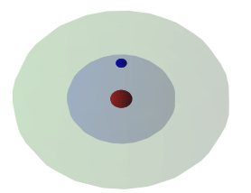

Slide 4
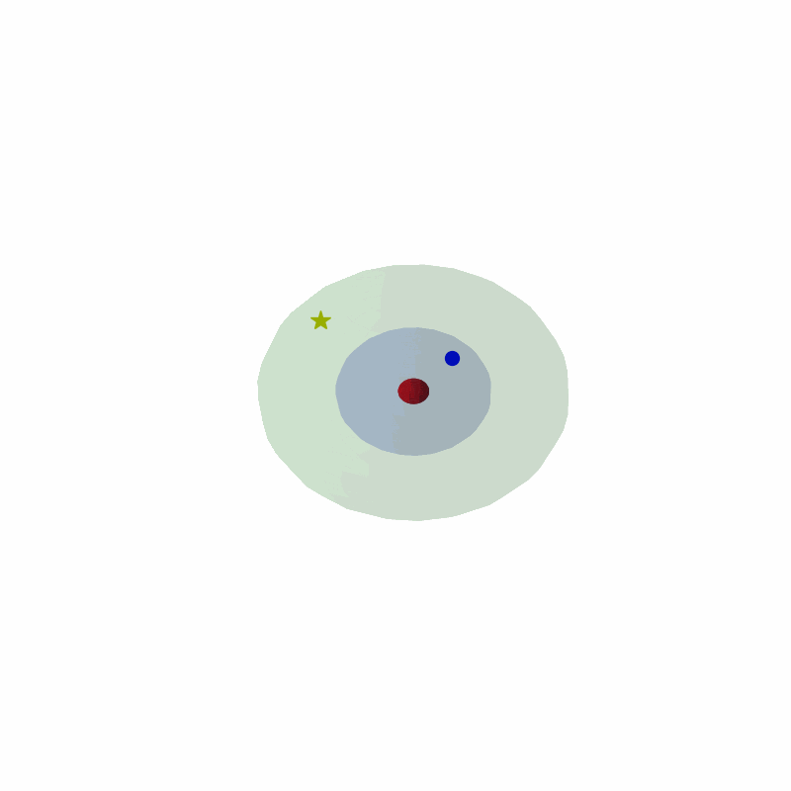

Slide 5
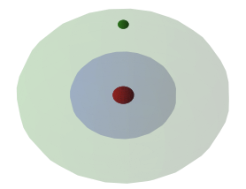

Slide 6
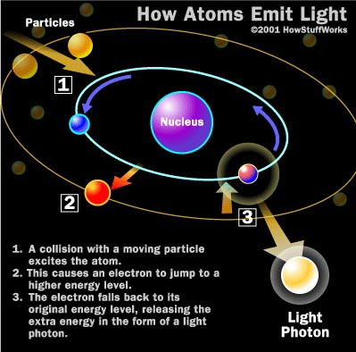

Slide 7
Bulk Matter

Slide 8
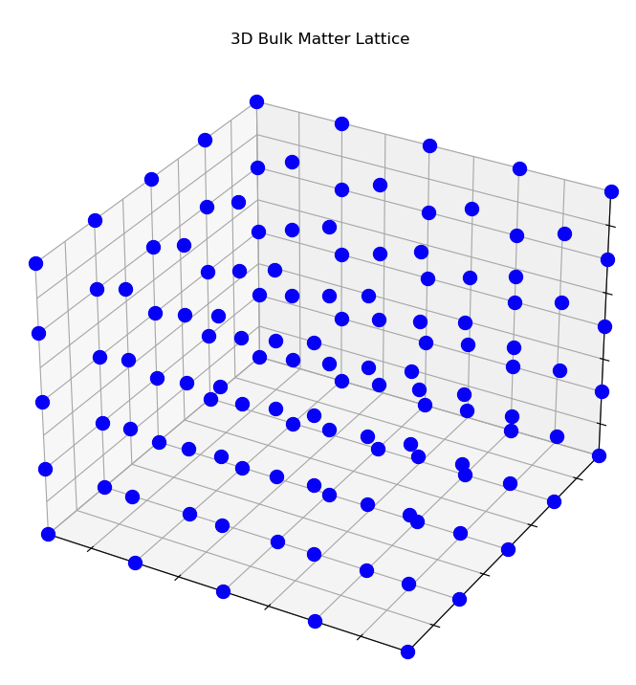

Slide 9
Bulk Matter - Main Features
Metals or bulk semiconductors.
Atoms are organized in a 3D lattice
The atoms are closed- Their electron orbitals (mainly the valence) intersect
An outcome of every intersection is:
An orbital with a lower energy
An orbital with a higher energy
We have an orbital with a higher energy than the valence orbital
We have nearly continuous energy bands

Slide 10
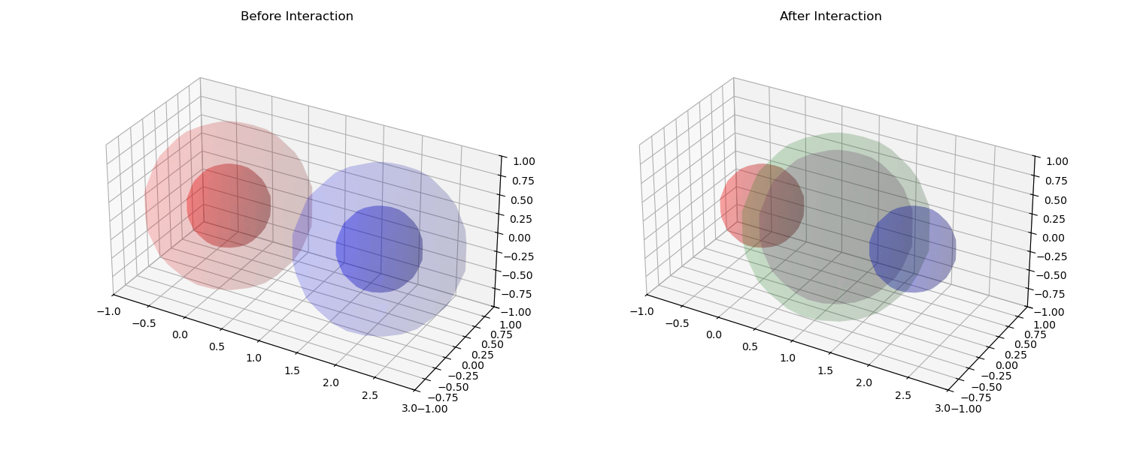

Slide 11
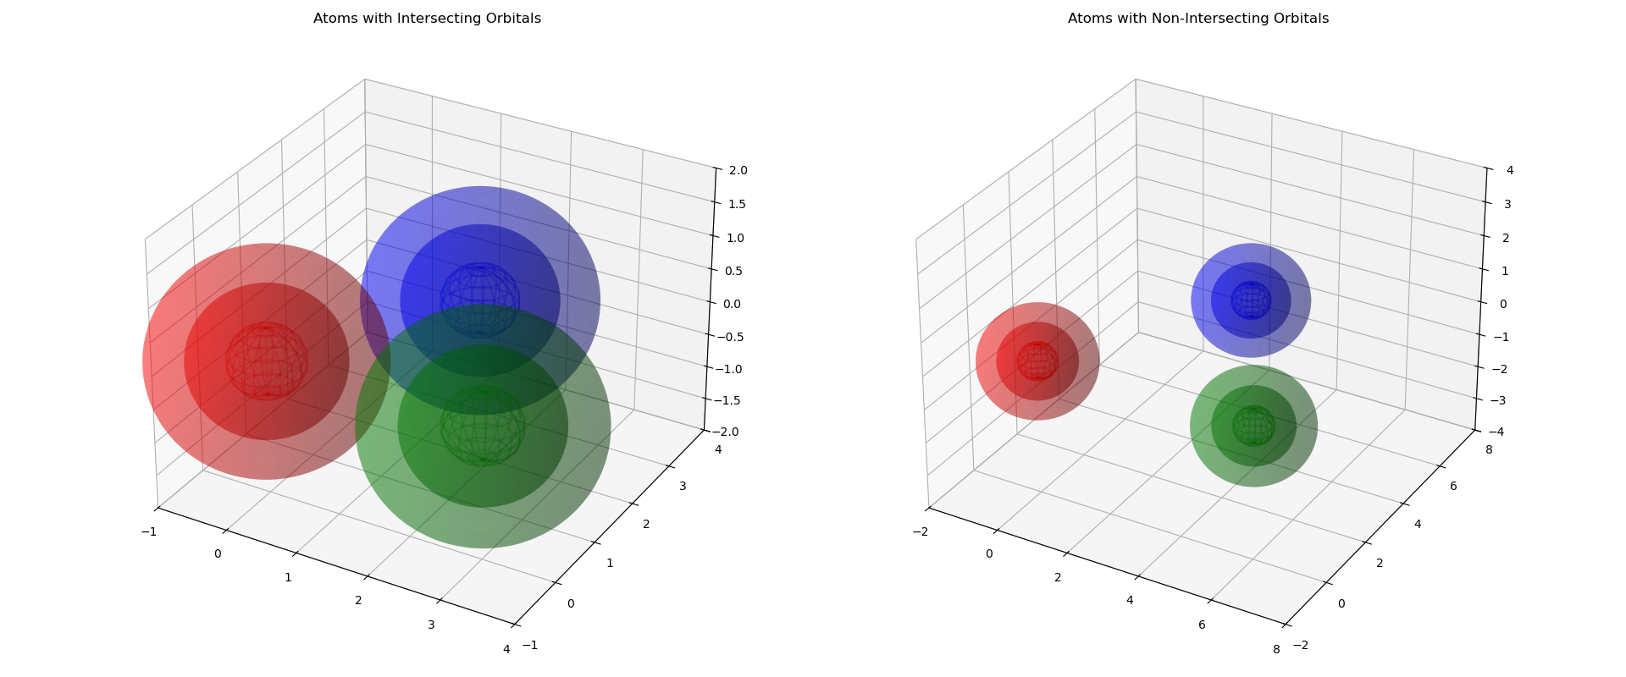

Slide 12
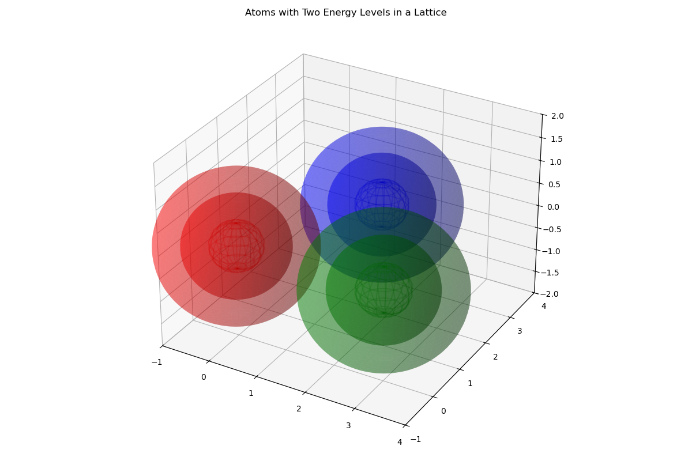

Slide 13
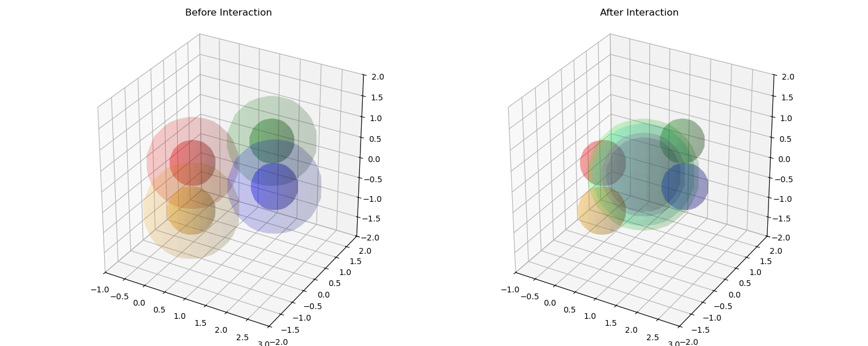

Slide 14
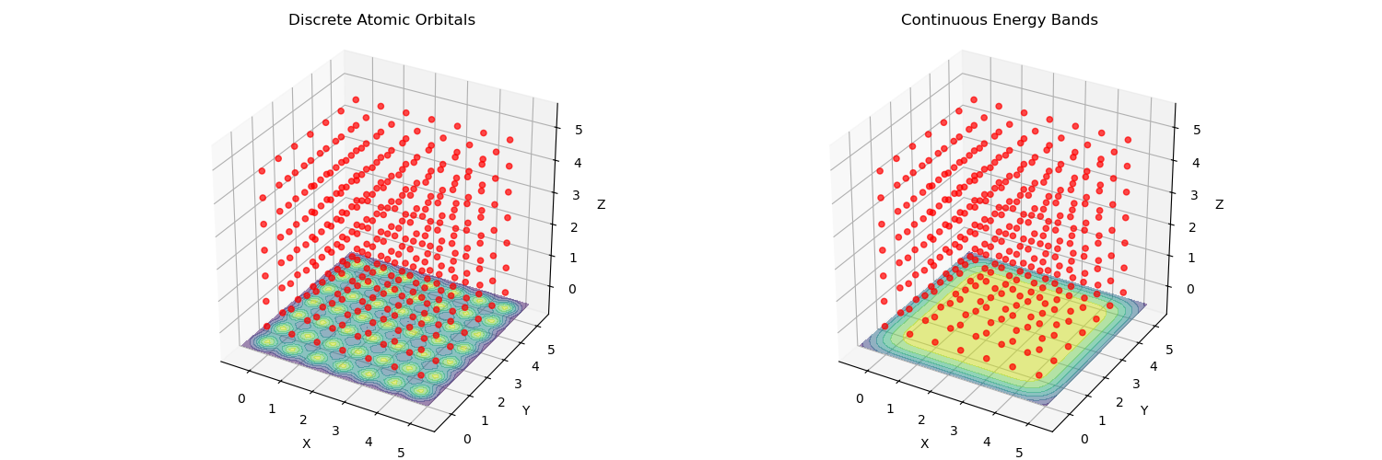

Slide 15
Quantum Dots

Slide 16
What are QD?
Quantum dots are nanoscale semiconductor structures, typically 2-10 nanometers in size
Examples
Cadmium selenide (CdSe)
Cadmium telluride (CdTe)
Indium arsenide (InAs)
Lead selenide (PbSe)
Gallium Arsneids(GaAS)

Slide 17
Quantum Dots: From Molecules to Nanocrystals
Bulk Materials: Continuous Bands:
In bulk materials, like metals or semiconductors, we have an enormous number of atoms, leading to an immense number of interactions.
These interactions result in a vast number of closely spaced energy levels, forming what we call 'continuous bands'.
Think of it as a ramp of energy levels, where electrons can occupy any point.
Quantum Dots: Discrete Levels:
Quantum dots are nanoscale crystals, containing a finite, but controllable, number of atoms.
With fewer atoms, there are fewer interactions, and the energy levels become more spaced out, or 'discrete'.
Analogy:
Think of it like the difference between a large orchestra (bulk) producing a continuous range of sounds, and a small ensemble (QD) producing distinct notes.

Slide 18
Quantum Confinement: The Impact of Limited Interactions
Beyond Size:
It's not just the small size of quantum dots that leads to discrete energy levels. It's the resulting limitation of interactions.
We call this 'quantum confinement', but it's more about the reduction of degrees of freedom.
Fewer Atoms, Fewer Splittings:
With fewer atoms, there are fewer interactions and therefore fewer 'splittings' of energy levels.
This results in larger energy gaps between the discrete levels.
Electron Movement:
Electrons in quantum dots need more energy to move between these discrete levels compared to electrons in bulk materials
It's not that confinement magically creates discrete levels. It's that it removes the interactions that created the continuous bands in the first place

Slide 19
QD Features
Semiconductors
They are a collections of atoms with orbital splitting that generate higher energy level
They have higher energy level than the valence -Conduction band
Atoms
They have Discrete energy levels
Electrons cannot move freely in the space as bulk matter -Quantum confinement

Slide 20
Tunability: The Chemist's Playground at the Nanoscale
Size and Composition Control:
The size and composition of quantum dots can be precisely controlled during synthesis.
This allows us to tailor their electronic and optical properties.
Energy Level Spacing:
The smaller the quantum dot, the fewer atoms it contains, and the more spaced out the energy levels become.
This means that we can tune the energy gap by changing the size of the quantum dot.
Optical Properties:
Quantum dots can absorb and emit light at specific wavelengths, depending on their size and composition.
This makes them useful for applications in lighting, displays, and bioimaging
Chemical Functionality:
The surface of quantum dots can be functionalized with various ligands, allowing for chemical control and integration into different systems.

Slide 22
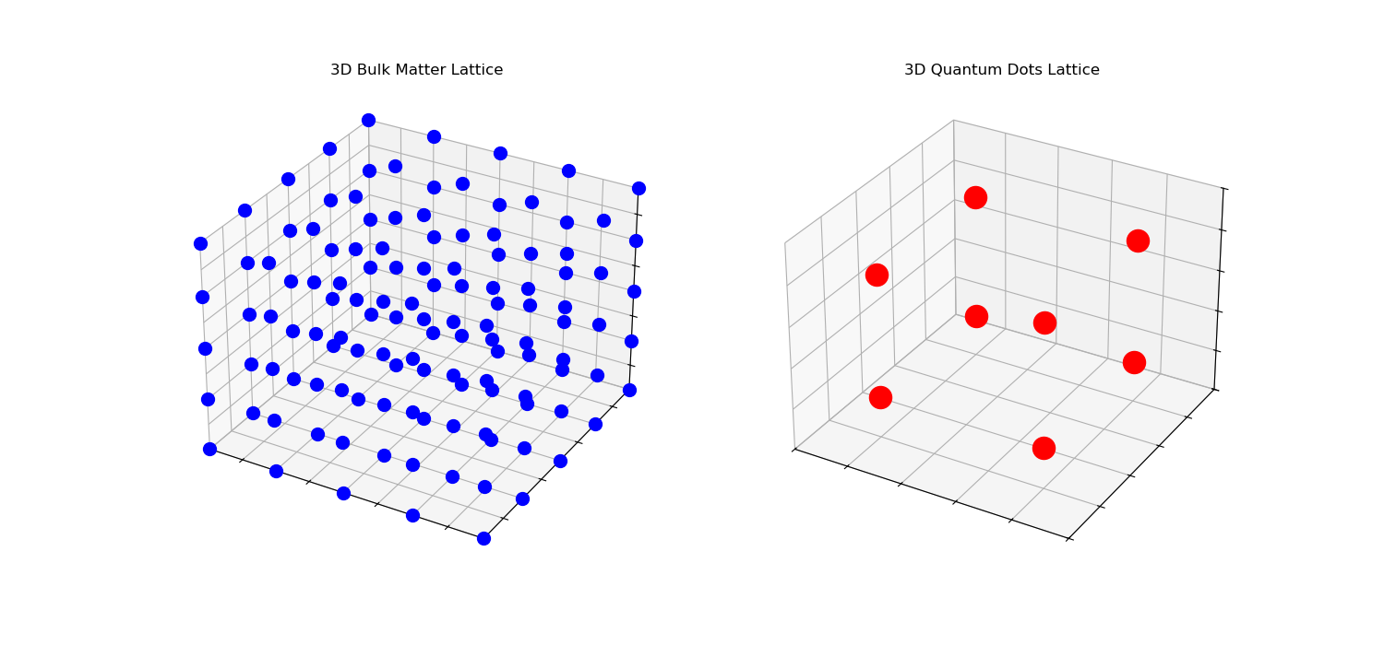

Slide 23
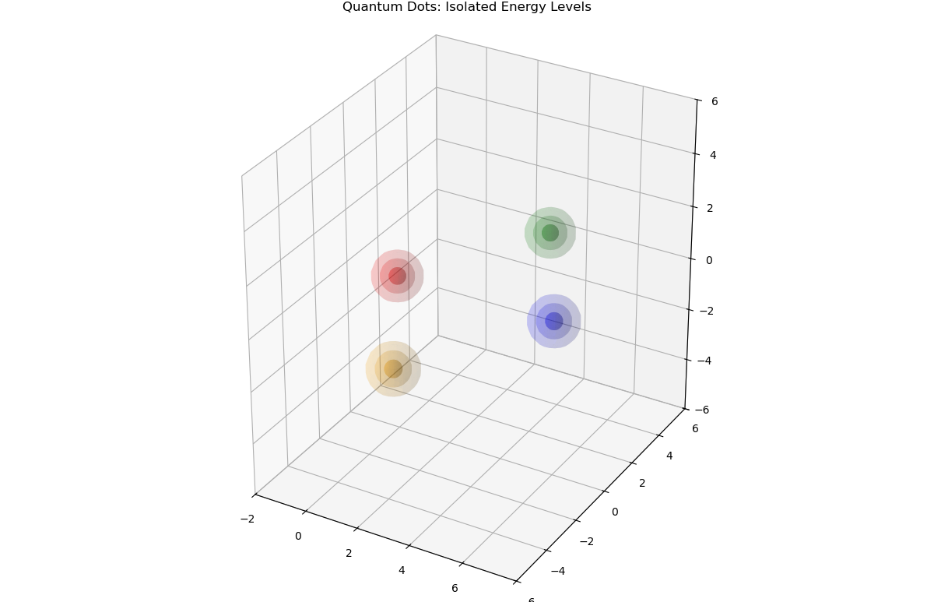

Slide 24
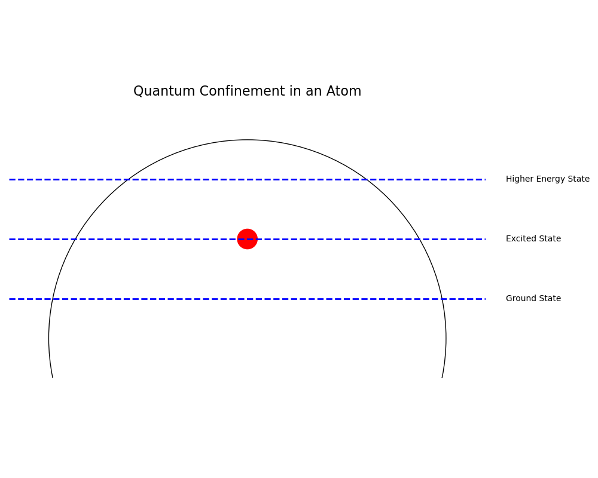

Slide 25
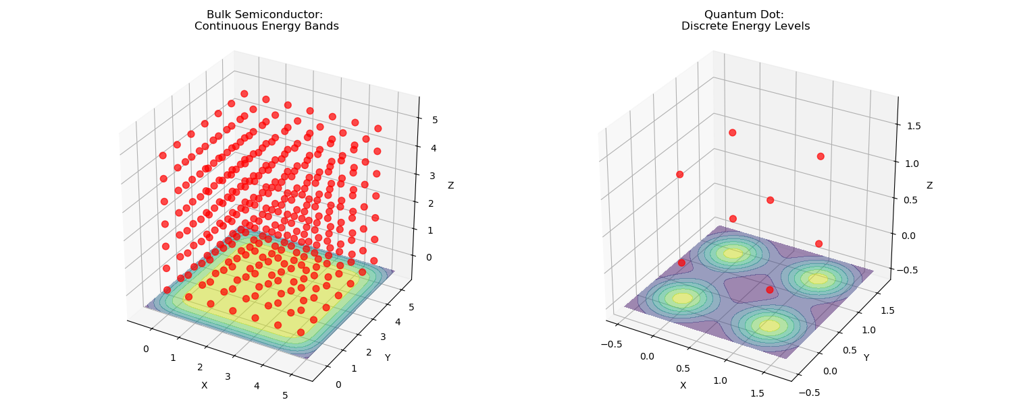

Slide 26
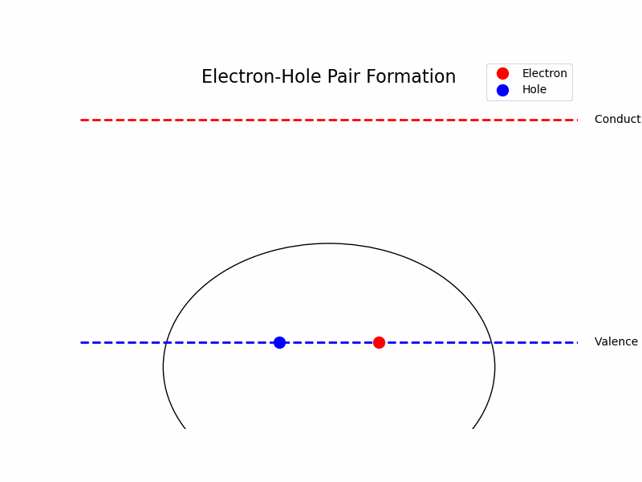

Slide 27
Qubits

Slide 28
Quantum Dots for Quantum Computing: Superposition States
Qubit Representation:
In quantum computing, we use qubits, which can exist in a superposition of two states, |0⟩ and |1⟩.
In a quantum dot, we can define these states based on the presence or absence of an electron in a specific energy level.
Superposition Creation:
By applying a carefully timed pulse of energy (e.g., light), we can create a superposition state, where the electron is in both energy levels simultaneously.
Electron Excitation:
Applying a precise amount of energy excites an electron from a lower (valence-like) to a higher (conduction-like) level, changing the qubit state.
Future Connection:
Understanding electron control in quantum dots prepares us for more advanced quantum systems, like topological superconductors, where qubits are defined by topological properties

Slide 29
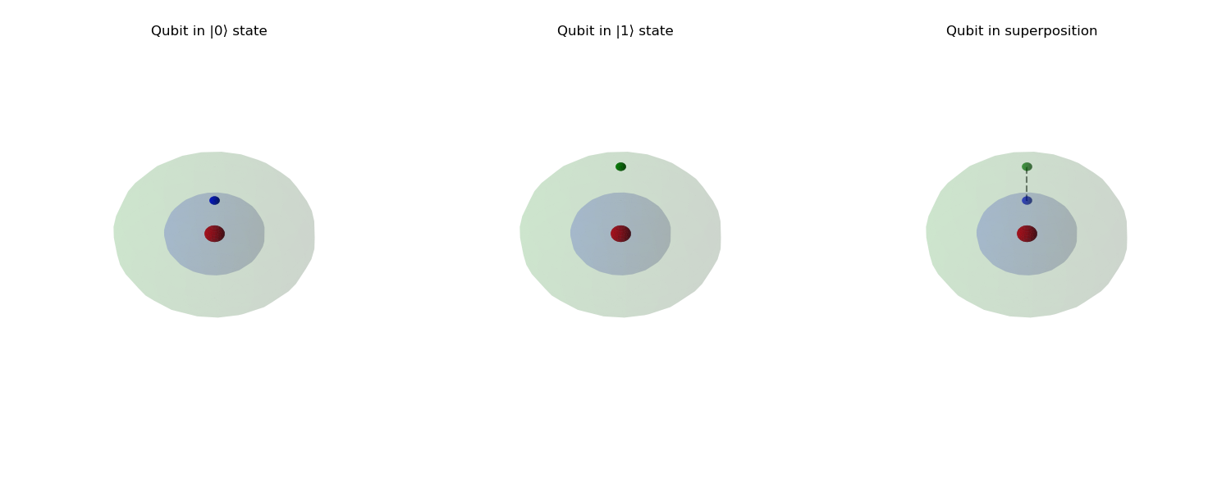

Slide 30
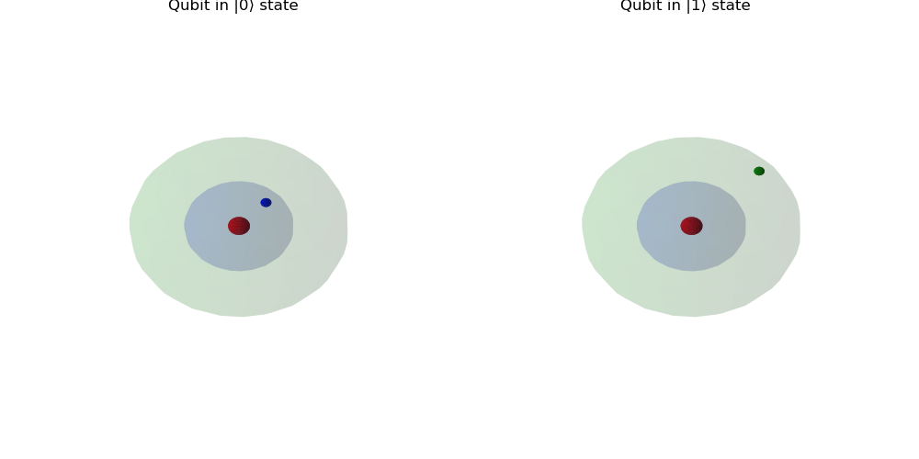

Slide 32
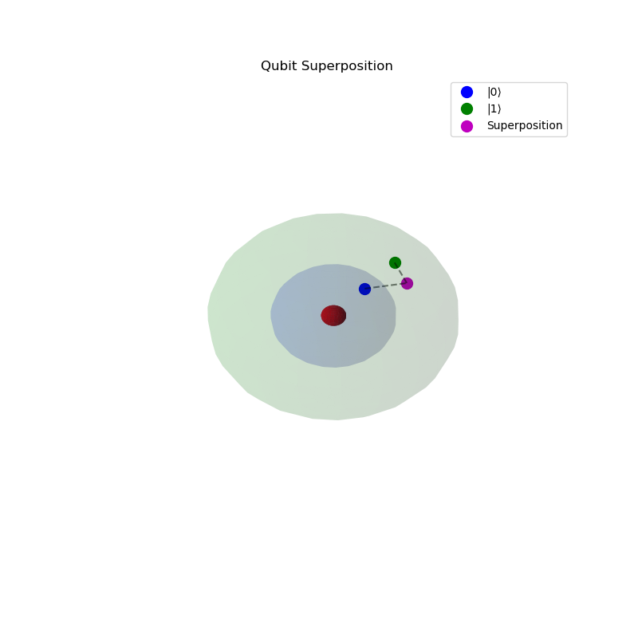

Slide 33
Light
Emission

Slide 34
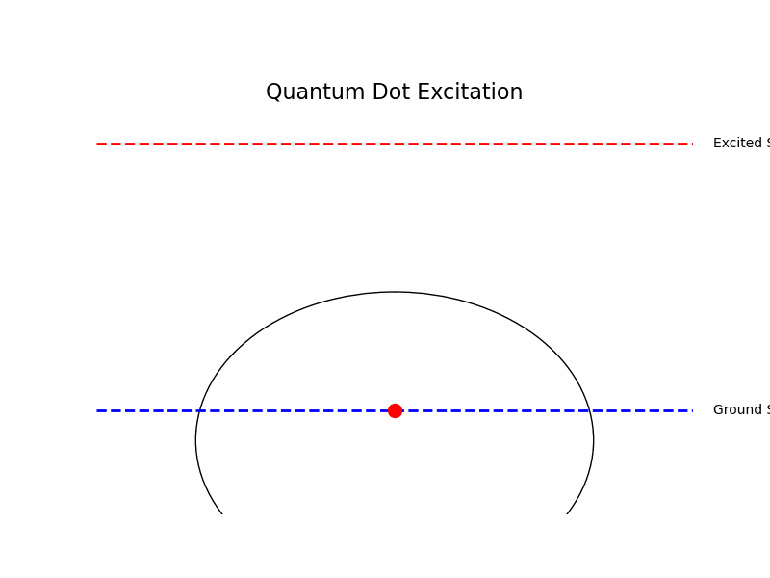

Slide 35


Slide 36
Industrial
Usage

Slide 37
Common Industrial sage
Displays and Lighting
QDs are used in flat panel displays and colored lighting for improved color accuracy and energy efficiency .
Applications in TVs, monitors, and LED lighting.
Biomedical Imaging
QDs serve as fluorescent markers for biological and medical diagnostics .
Enhanced imaging for cellular processes and tumor targeting.
Photodetectors
QDPs (Quantum Dot Photodetectors) are used in visible and infrared light cameras .
Applications in machine vision, industrial inspection, and spectroscopy.
Photovoltaics
QDs are being explored for improving solar cell efficiency .
Photocatalysts
Used in light-driven chemical conversion of water into hydrogen for solar fuel .

Slide 38
The promise of QD in QC
Confinement effects:
QDs confine electrons in three dimensions, creating discrete energy levels similar to atoms
This confinement allows for precise control of individual electrons and their quantum states .
The confinement also leads to enhanced quantum effects and tunable properties .
Semiconductor technology:
QDs can be fabricated using existing semiconductor techniques, making them compatible with current manufacturing processes
This allows for integration with nanophotonic structures and scalability
Enhanced coherence:
The combination of confinement and semiconductor technology leads to improved coherence in QDs .
Coherence times can be extended to the microsecond regime under certain conditions .
The ability to manipulate QDs using electrostatic electrodes and optical pulses allows for coherent control and decoupling techniques

Slide 39
Further
Properties

Slide 40
Another approach to QC
Consider a wire and two QDs
QDs in nanowires provide tunable energy barriers, allowing for well-defined, discrete energy levels that can be manipulated through external fields.
Nanowires act as one-dimensional channels, facilitating coherent electron movement with reduced scattering between QDs and along the wire.
The nanowire-QD system is highly scalable, compatible with semiconductor fabrication techniques and allows for fine-tuning of electronic properties through size and composition engineering.
If we add to this settings a tool that can measure the parity of the electrons on the nanowire we can have a new type of stable qubit

Slide 41
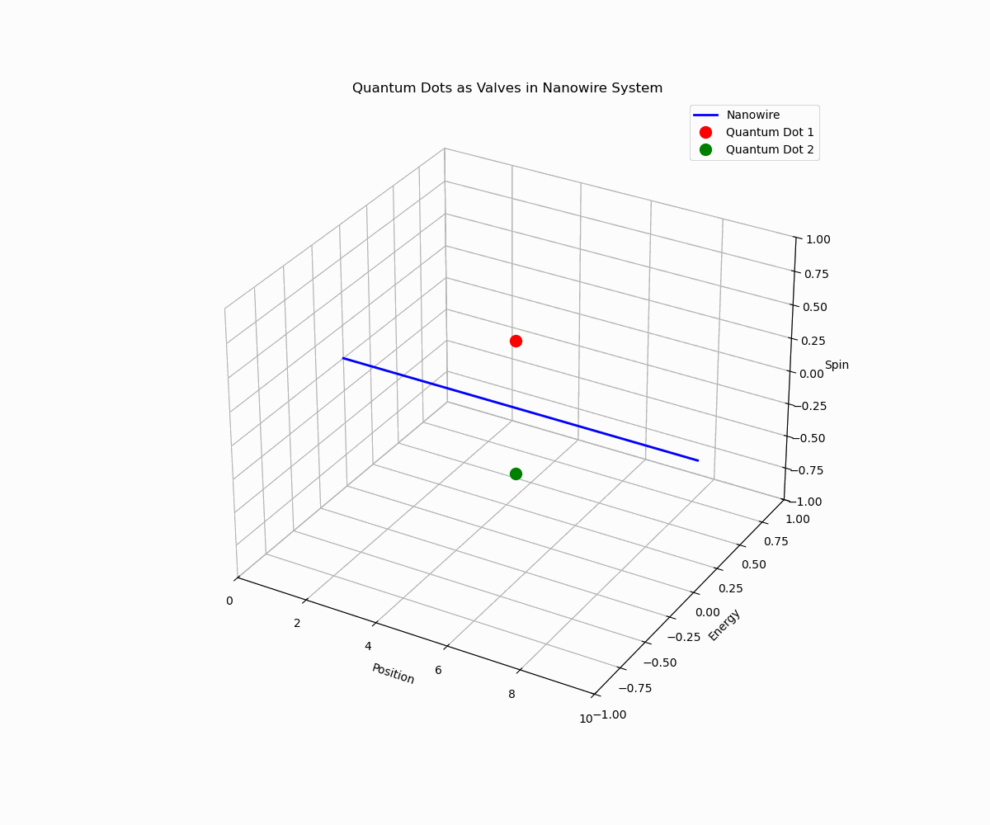

Slide 42
Little
Physics

Slide 43
Fermions
What is a Fermion?
A fundamental particle that follows the Pauli exclusion principle (no two can occupy the same state).
The core building block of all matter.
Examples of Fermions:
Electrons, protons, and neutrons are all fermions and form the building blocks of matter.
Fermion Properties in Quantum Systems:
They have half-integer spin (e.g., 1/2, 3/2) and obey Fermi-Dirac statistics, crucial for quantum mechanics and solid-state physics.

Slide 44
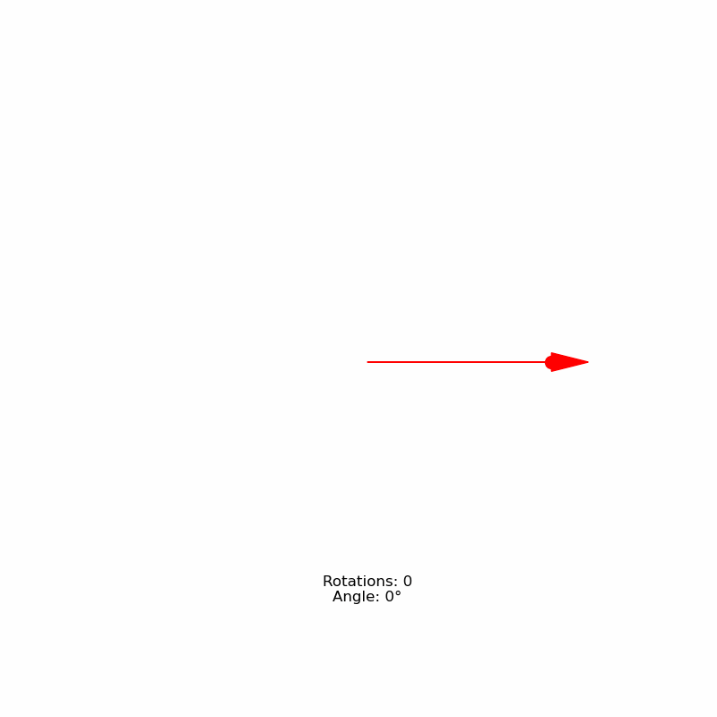
Fermion -Spin ½

Slide 45
Dirac operator & Majorana Equation
In 1928 Dirac’s operator : I t has complex solutions namely every solution has its adjoint hence every particle has an antiparticle
In 1937 Majorana wrote Dirac’s equation in a way that allows real solutions
A particle that is its antiparticle too
Majorma zero (MZMs)
There are no evidences that it exists -it is not particle but quasiparticle
If it does, edges of nanowire are good place to start

Slide 46
Dirac Equation - 1928
Motivation for the Dirac Equation
Quantum mechanics successfully described fermions, but there was no equation consistent with special relativity.
Dirac sought an equation that naturally included spin-1/2 particles and predicted their behavior at high speeds.
His equation also predicted antimatter, an entirely new concept at the time.
What is the Dirac Equation?
A fundamental equation describing fermions like electrons and predicting their behavior in quantum mechanics and relativity.
It explains the existence of antimatter and the intrinsic spin of fermions.
Provides a framework for understanding the quantum world at high speeds.

Slide 47
Majorana Equation -1937
Dirac Equation has complex solutions that were interpreted as a particle and its antiparticle.
Majorana, motivated by a desire for a simpler, more 'real' description of particles, searched for a more elegant solution and rewrote the Dirac operator in a Hermitian form in order to study real solutions.
Physics interpreted his work as a prediction of a particle that is its own antiparticle, known as a Majorana fermion.

Slide 48
Fermion Parity
The Majorana equation leads to a quantum number known as Fermion Parity, which indicates the parity of fermions in a system
Fermion Parity in Majorana Fermions:
Majorana fermions are associated with zero fermion parity, meaning they exist in systems where the particle and antiparticle are indistinguishable.
This unique parity is central to topological quantum computing, where stability is guaranteed by fermion parity.
Fermion Parity in Electrons:
For conventional fermions like electrons, the fermion parity counts whether the number of fermions in a system is even (+1) or odd (-1).
Example: Two electrons → even parity (+1), One electron → odd parity (-1).
Why Fermion Parity Matters:
Topological Quantum Computing: Majorana fermions with distinct parity offer stable qubits, resistant to quantum decoherence.

Slide 49
Majorana Zero Modes (MZMs) vs. Majorana Fermions
Majorana fermions are fundamental particles that are their own antiparticles. These are theoretical particles in high-energy physics (e.g., hypothesized for neutrinos), but they have never been observed experimentally.
MZMs, on the other hand, are quasiparticles—not fundamental particles. They emerge from the collective behavior of electrons in a topologically protected state in condensed matter systems.
MZMs come in pairs: two MZMs at the ends of a wire (or similar systems) are required to form a single Majorana mode. This is in contrast to Majorana fermions, which do not have to exist in pairs.
MZMs exhibit Majorana-like behavior because they are self-conjugate (meaning their own antiparticles in the system), but they are still composed of real electrons and emerge due to the topological properties of the system rather than being fundamental particles.
We can use fermion parity to measure MZMs pairs

Slide 50
Majorana Zero Modes (MZMs) vs. Majorana Fermions
Majorana fermions are fundamental particles that , but they have never been observed experimentally.
MZMs, on the other hand, are quasiparticles—not fundamental particles. They emerge from the collective behavior of electrons in a topologically protected state in condensed matter systems.
MZMs come in pairs: two MZMs at the ends of a wire (or similar systems) are required to form a single Majorana mode. This is in contrast to Majorana fermions, which do not have to exist in pairs.
MZMs exhibit Majorana-like behavior because they are self-conjugate (meaning their own antiparticles in the system), but they are still composed of real electrons and emerge due to the topological properties of the system rather than being fundamental particles.

Slide 51
An Intermediate Summary
Fermion Parity and MZMs:
Majorana Zero Modes (MZMs) arise at the ends of topological wires and are quasiparticles that exhibit Majorana-like behavior.
Fermion parity (even or odd) can be altered through topologically protected states, allowing us to manipulate the quantum state of the system.
On a single wire, however, we cannot directly measure an odd fermion parity. The system is constrained by the way MZMs are paired at the wire ends.
Challenges with Odd Parity:
While we can generate MZMs with different parity configurations, the odd parity state can’t be accessed directly on a single wire.
MZMs come in pairs: each wire end supports one, and they can’t be isolated or independently manipulated for odd parity.

Slide 52
An Intermediate Summary
Majorana Zero Modes (MZMs) arise at the ends of topological wires and are quasiparticles that exhibit Majorana-like behavior.
Fermion parity (even or odd) can be altered through topologically protected states, allowing us to manipulate the quantum state of the system.
On a single wire, however, we cannot directly measure an even fermion parity.
Challenge - We cannot measure even parity directly!!
.

Slide 53
Braiding
Braiding refers to the process of interchanging the positions of Majorana Zero Modes (MZMs) typically done in systems like nanowires or quantum dots
It involves moving MZMs around each other in a controlled manner, which changes the system’s global quantum state.
Braiding allows for the manipulation of fermion parity and enables the measurement of odd fermion parity, which would otherwise be inaccessible in a single wire.
Braiding enables us to overcome the limitation of single-wire systems, and achieving robust quantum states—this is fundamental for topological quantum computing.
Since it is robust it can be beneficial for logical qubits -If one pair is destroyed there are other pairs

Slide 54
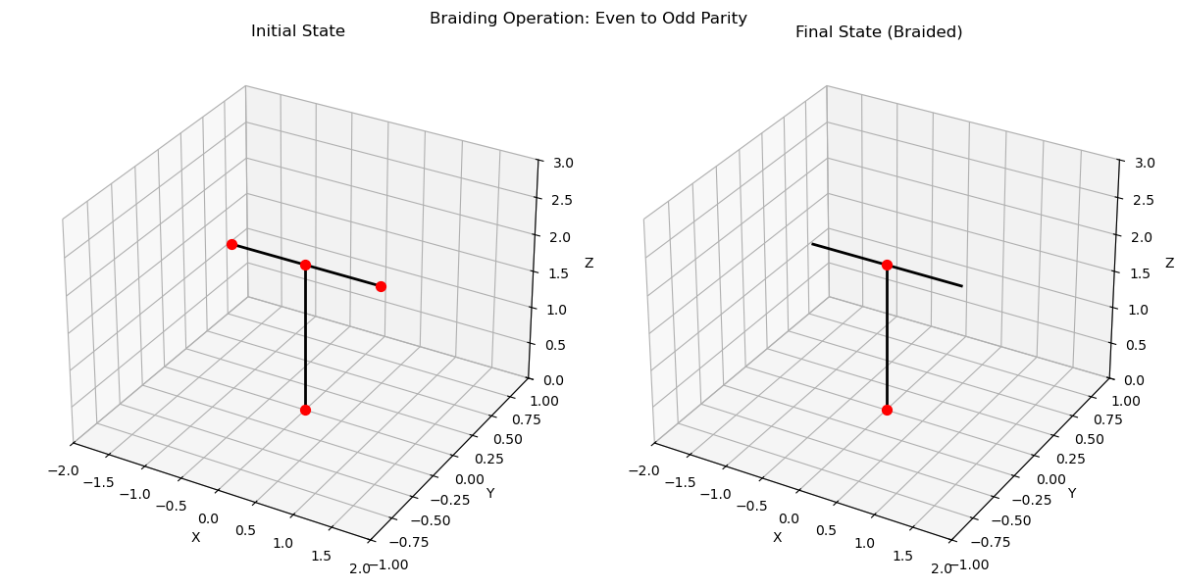

Slide 55
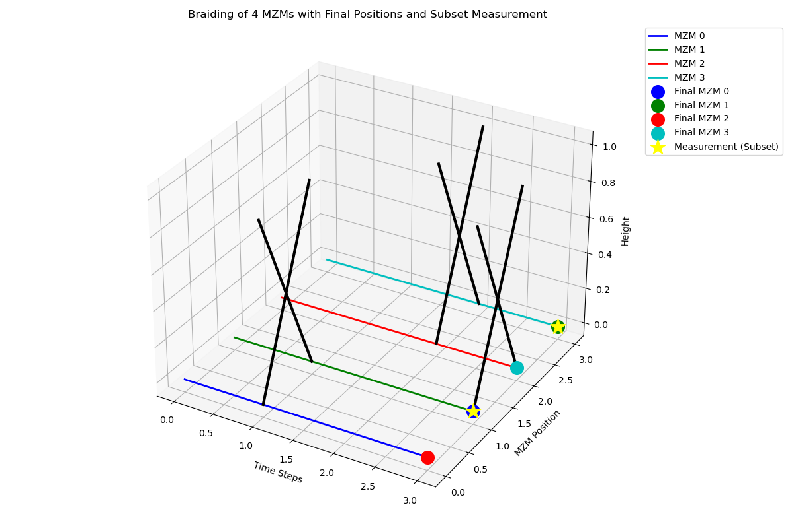
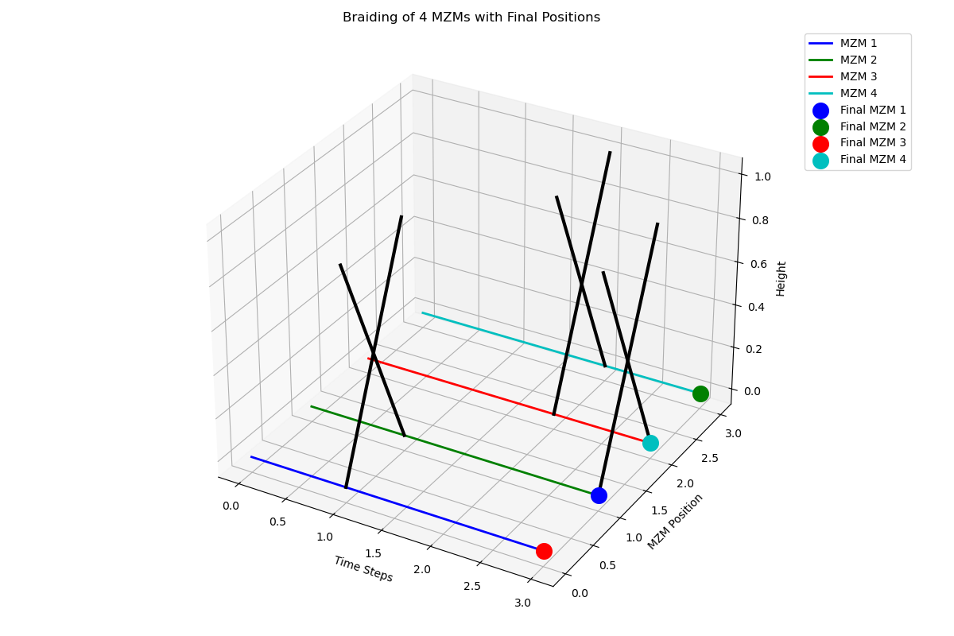

Slide 57
MSN
Majorana 1
2024

Slide 58
From Semiconductor to Topological Superconductor
Semiconductors are materials that have a band gap thus can be tuned to conduct or no, and control electrical conductivity
Superconductors, when cooled below a critical temperature, exhibit zero electrical resistance and expel magnetic fields (Meissner effect)
When a superconductor is brought into a semiconductor, some properties 'leak' into the semiconductor (the proximity effect)
When we combine the proximity effect with magnetic field (Zeeman effect) , we achieve a transition that the wire becomes topological superconductor (topological superconductor phase)
A topological superconductor cas host MZMs at its boundaries and they are topologically protected, meaning they are robust against local perturbations

Slide 59
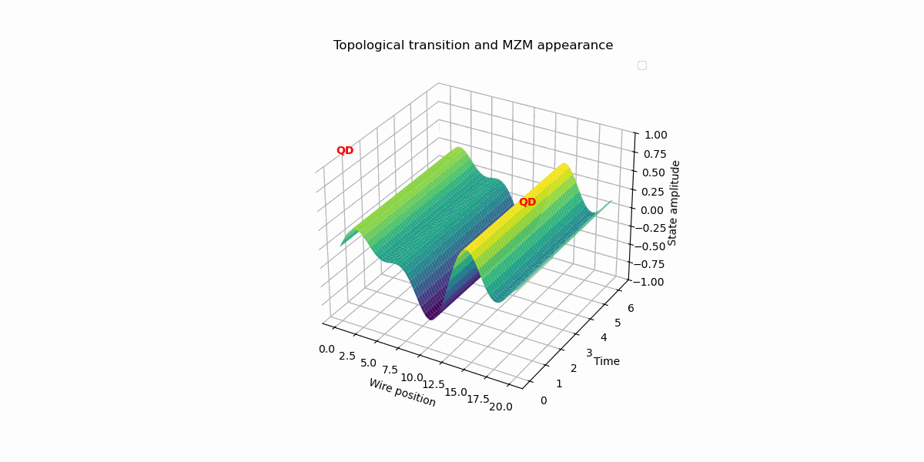

Slide 60
Majorana 1: Creating the Topological Superconductor
A semiconductor nanowire (e.g., InAs) with nanometer diameter and micrometer length (3-4 μm) is fabricated
A superconducting material (e.g., Al) is attached to the nanowire
The superconducting proximity effect induces a 'soft' superconducting gap in the nanowire electronic spectrum
A quantum dot is integrated to provide precise electrostatic control, acting as a 'tuning knob' for the nanowire's properties, specifically tuning the initial superconducting gap
First energy gap is generated

Slide 61
Majorana 1 Generating and Detecting (MZMs)
Using Zeeman effect MSN perform a translation to the topological superc phase that reopens the energy gap
MZMs are generated at the edges of the nanowires
MSN use the QD to finetune the gaps and enhance the MZMs stability
Performing fermion parity measurement

Slide 62
Readout -Fermion Parity via Quantum Dot (QD) Sensing
We need to measure fermion parity - Namely the number of MZM pairs
Quantum Dot (QD) as a Sensitive Sensor:
The QD, utilizing its semiconducting properties, acts as a highly sensitive sensor of the nanowire's electronic state.
It is placed in close proximity to the nanowire, enabling electrostatic control.
Electrostatic Control and Charge Sensitivity:
Voltages applied to the QD control its electrostatic potential and charge state
Changes in MZM fermion parity induce changes in the nanowire's charge distribution, affecting the QD's charge state.
Charge Sensing: Directly measuring the QD's charge state to infer fermion parity
Tunneling Measurements: Measuring tunneling current through the QD, which is sensitive to MZM presence and parity
Challenges and Considerations:
Maintaining MZM topological protection during readout is crucial
Noise and decoherence can impact measurement accuracy
The QD's role is to tune the potential landscape, not to directly block electrons

Slide 63
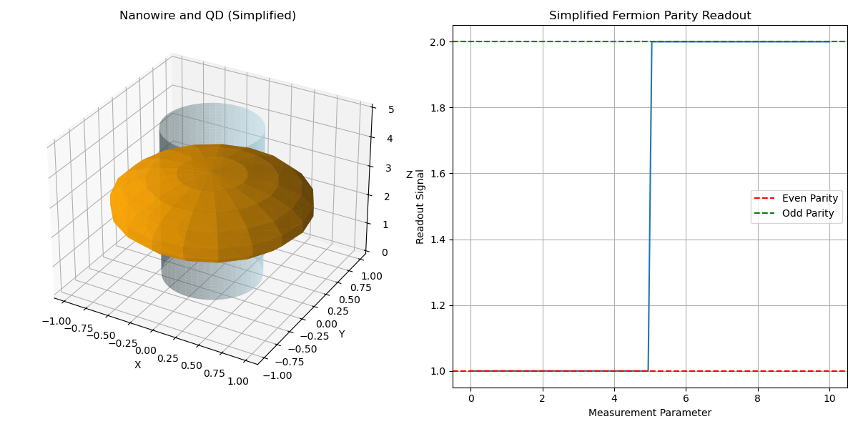

Slide 64
Future improvements
Theoretical study
Non-Abelian Braiding Statistics
Computational modeling
Scalable Architectures and Qubit Networks
Develop multi-qubit systems and design scalable circuits
Integrate with conventional QEC methods
Advanced Braiding Operations
Implement fault-tolerant quantum gates
Develop precise MZM manipulation techniques
System Integration and Control
Bridge topological qubits and classical electronics
Enhance measurement and readout fidelity
Develop efficient control interfaces

